Slide 1



Mobile Care Services Discovery
Luke Duncan / Carl Leitner IntraHealth International, Inc.

Slide 2
The Problem
There is increasing interest globally in the use of the RESTful standards for accessing interlinked information on:
health care providers
the services they provide
the facilities where they work
the organizations they work for
The information needed to query usually comes from a federation of data sources (ministries of health, service delivery networks, professional councils/boards, etc).

Slide 3
The Needs
A clear outcome of a recent ONC Provider Directory workshop was that new directions are needed and there was a lot of vendor interest in the use of RESTful API (e.g. FHIR) for accessing provider and service information and we are likely to see FHIR endpoints added to existing provider directories (e.g. CAHIE, Redwood MedNet).
However, neither the roles played by actors interacting with a provider directory nor the management of multiple sources of health worker information were fully considered.
Many existing CSD deployments (iHRIS, mHERO, PEPFAR’s DATIM) would need an “upgrade path”

Slide 4
Existing Efforts
Current efforts only partially address the problem:
Care Services Discovery – does not address RESTful services
Healthcare Provider Directory – does not address RESTful services, facilities or services
Argonauts FHIR Provider Directory– does not address federation, specify actors, nor is it applicable for deployment contexts in Low and Middle Income Countries (e.g. requires NUCC and Direct address)

Slide 5
Work Item Sizing
Options:
Issue a large Change Proposal for Care Services Discovery to
specify FHIR transport for ITI-73 and ITI-74.
Create a cross-walk between FHIR and CSD data elements
Minor modifications to CSD Volume 1 to remove references to CSD’s XML data model
Develop Mobile Care Services Discovery (mCSD) profile to:
Adopt Vol 1 of CSD profile (actors, use cases, etc.)
Provide FHIR version of ITI-73 and ITI-74 transactions
As an appendix, add a cross-walk between CSD and FHIR data elements
Add Argonaut work as an option and/or national extension
Minor modification to CSD Volume 1 to remove reference to CSD’s XML data model
Develop a completely new profile

Slide 6
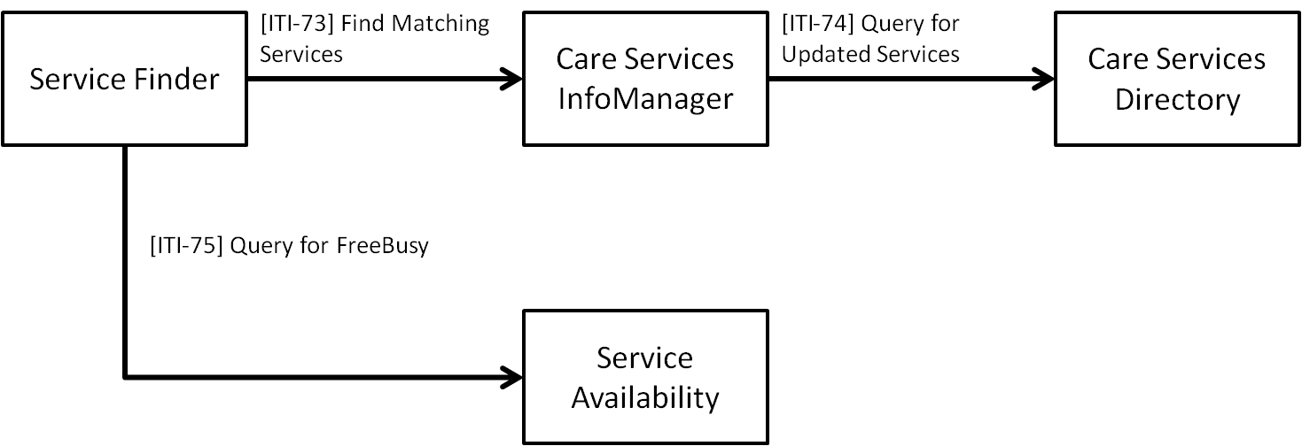
Care Services Discovery actors

Slide 7
Care Services Discovery Mapping
CSD Entity | FHIR Resource
Provider | Practitioner
Facility | Location
Organization | Organization
Service | Healthcare Service
CSD Transaction | FHIR Transaction
Provider Search ITI-73 | search operation on Practitioner resource
Facility Search ITI-73 | search operation on Location resource
Organization Search ITI-73 | search operation on Organization resource
Query for Updated Services ITI-74 | _history

